Slide 1


Cyber Crime
Police Station
Hyderabad City

Slide 2
Types of Cyber Crimes
1
Online Debit/Credit cards & Bank frauds
2
Social Media offences
3
Job/VISA Frauds
4
Loan, Insurance & Lottery
Marketing Intelligence &
OLX Frauds
5
6
Miscellaneous Frauds

Slide 3
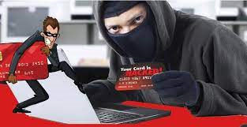
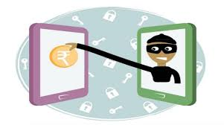

Online Debit/Credit Cards and Bank Frauds
Wishing calls to the victims in the name of bank officials
Credit Card reward points
Your Debit Card is being blacked, etc.,
UPI frauds by installing remote desktop apps such as Any Desk/ Team viewer apps

Slide 4

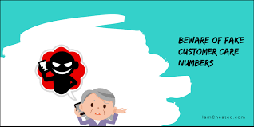
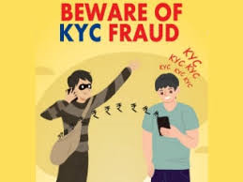
Sending UPI money request links and siphoning money
Impersonating as customer care support (Google Pay, Phonepe Amazon, snapdeal etc.,)
PayTM and other E-commerce wallet’s KYC updating frauds

Slide 5

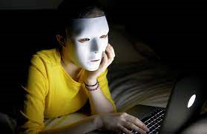


Social Media Offences
Fake id creation to defame the victim
Circulating lascivious material of the victim over social media
Keeping phone numbers of victims over dating websites
Facebook friendship (gift) frauds
Facebook friendship (Business) Frauds
Sextortion through facebook and other social media platforms

Slide 6

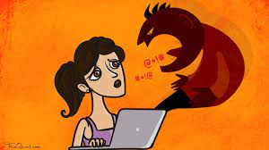


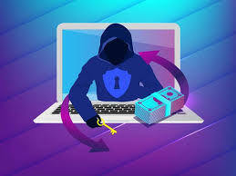
Keeping morphed photos of victims over social media
Circulating defamatory material over social media
Hacking the mails of companies and sending fake invoices to clients
Hacking of individual mails and sending money requests to friends
Hacking of mail account and demanding money
Ransomware Attacks

Slide 7



Job/VISA Offences
Fake Job offers
Visa processing on the name of abroad jobs
Backdoor Jobs
Impersonating as Job portal officials

Slide 8
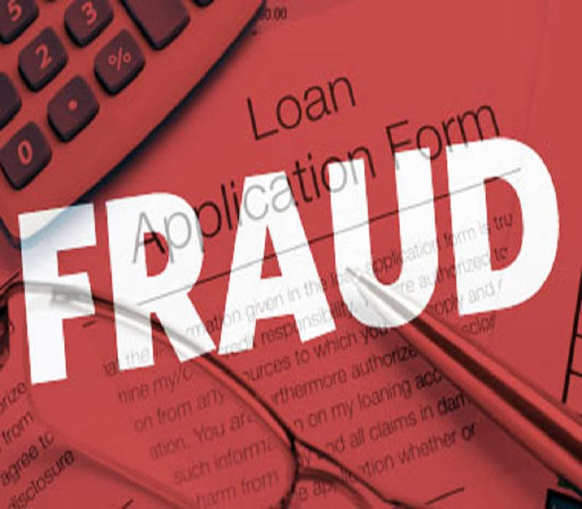

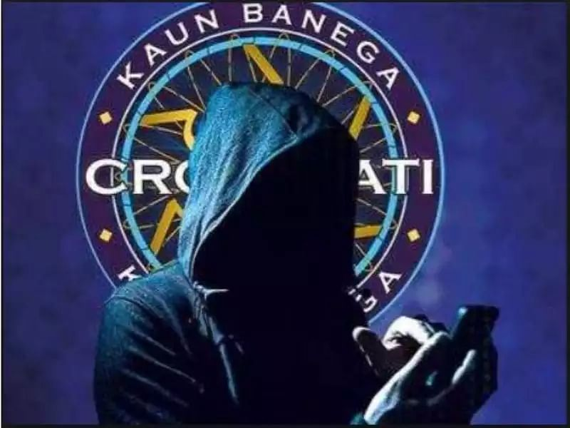
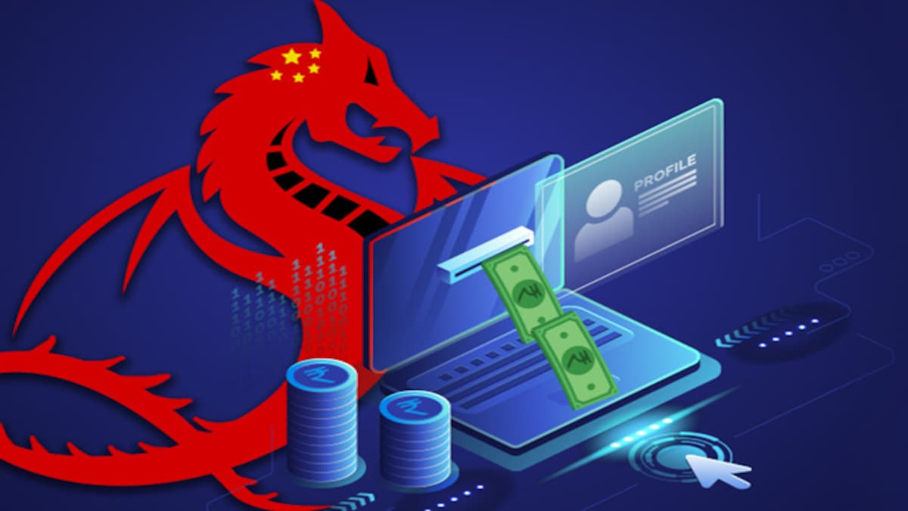
Loan, Lottery, Insurance Offences
Calls offering loan at unbelievable interest without sureties
Calls offering bonus over the existing insurance policy
Calls offering gift from shopping websites
SMS and Mails about winning of Coca Cola lottery
Calls regarding KBC lottery originated from Pakistan
Instant loan apps fraud

Slide 9
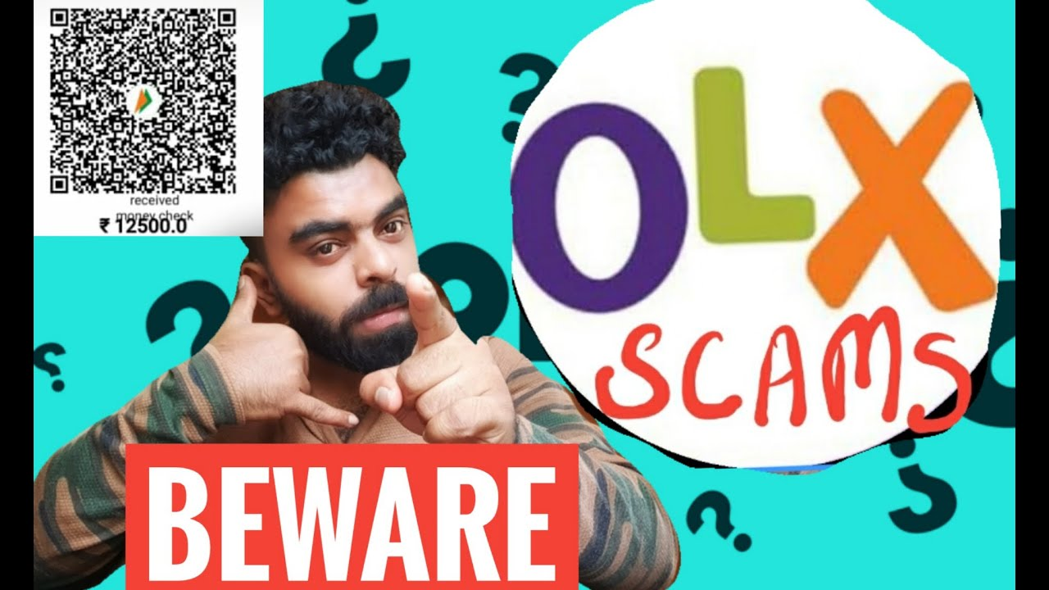
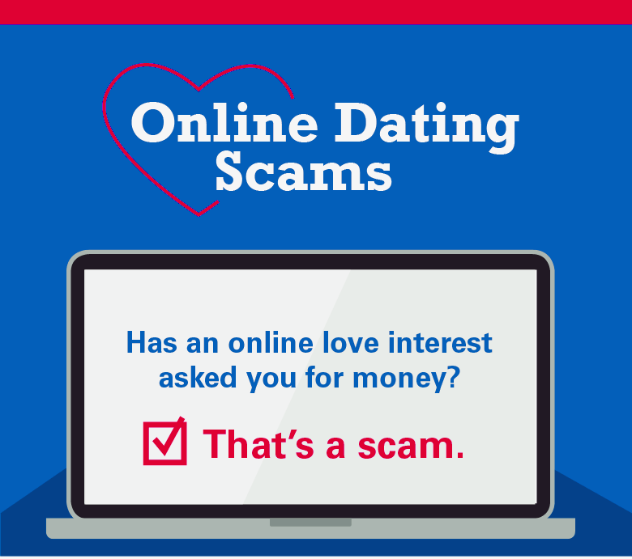
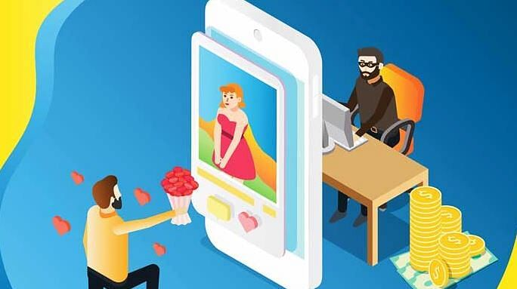
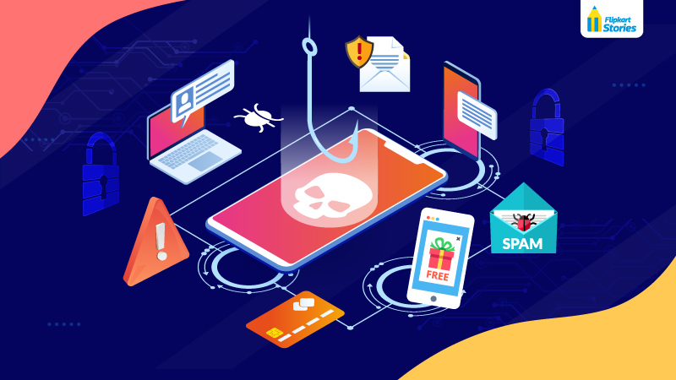
Marketing Intelligence & OLX Frauds
OLX and other social media advertising frauds
Surveillance over Dating websites
Surveillance over Locanto website
Surveillance over news advertisements
Male Escort Service Frauds

Slide 10



Miscellaneous Frauds
Fake investment websites & Apps scam on the name of higher returns in Crypto currency
Multi-level marketing scam on the pretext of higher returns in crypto currency.
Matrimonial frauds, Nigerian frauds

Slide 11
Target audience
Most Common people to be effected or attacked for scamming or phishing are :-
Job seeking Students
People with small Businesses
Uneducated People
Old age People (above age of 60)
Crypto Currency Investors

Slide 12
Thank you.
Best Wishes
From
ACP, Cyber Crime PS
Hyderabad City

